Slide 1

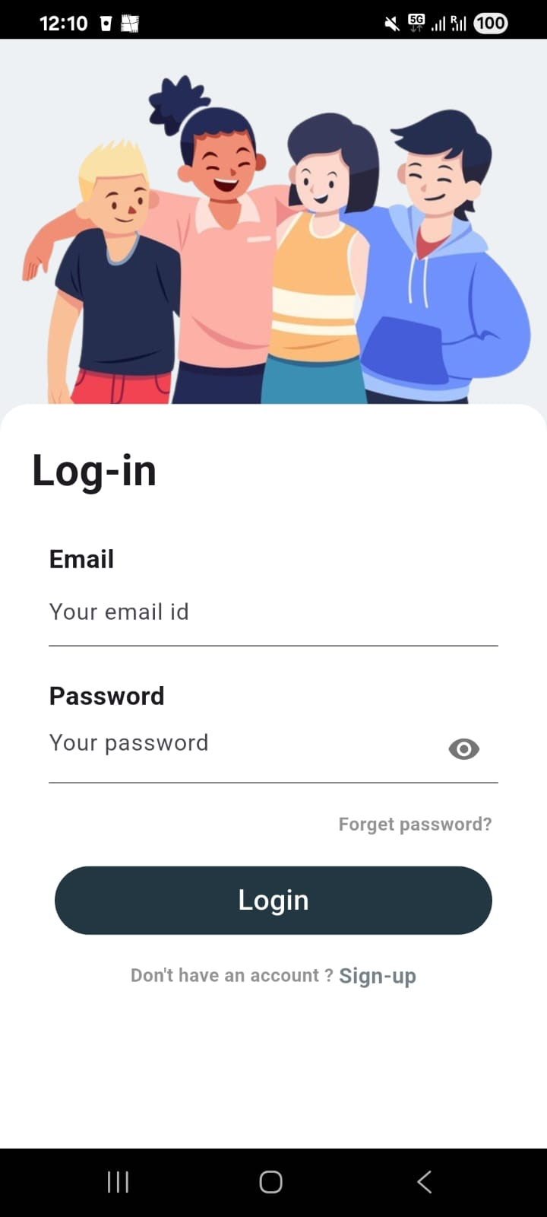
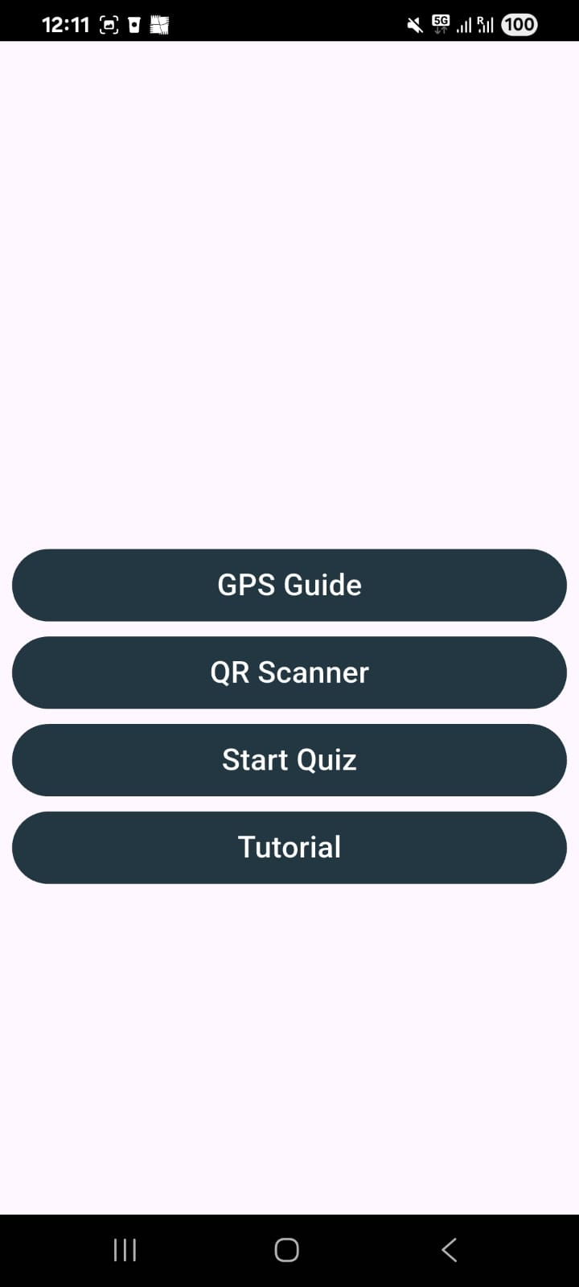
(a)
(b)
(c)

Slide 2
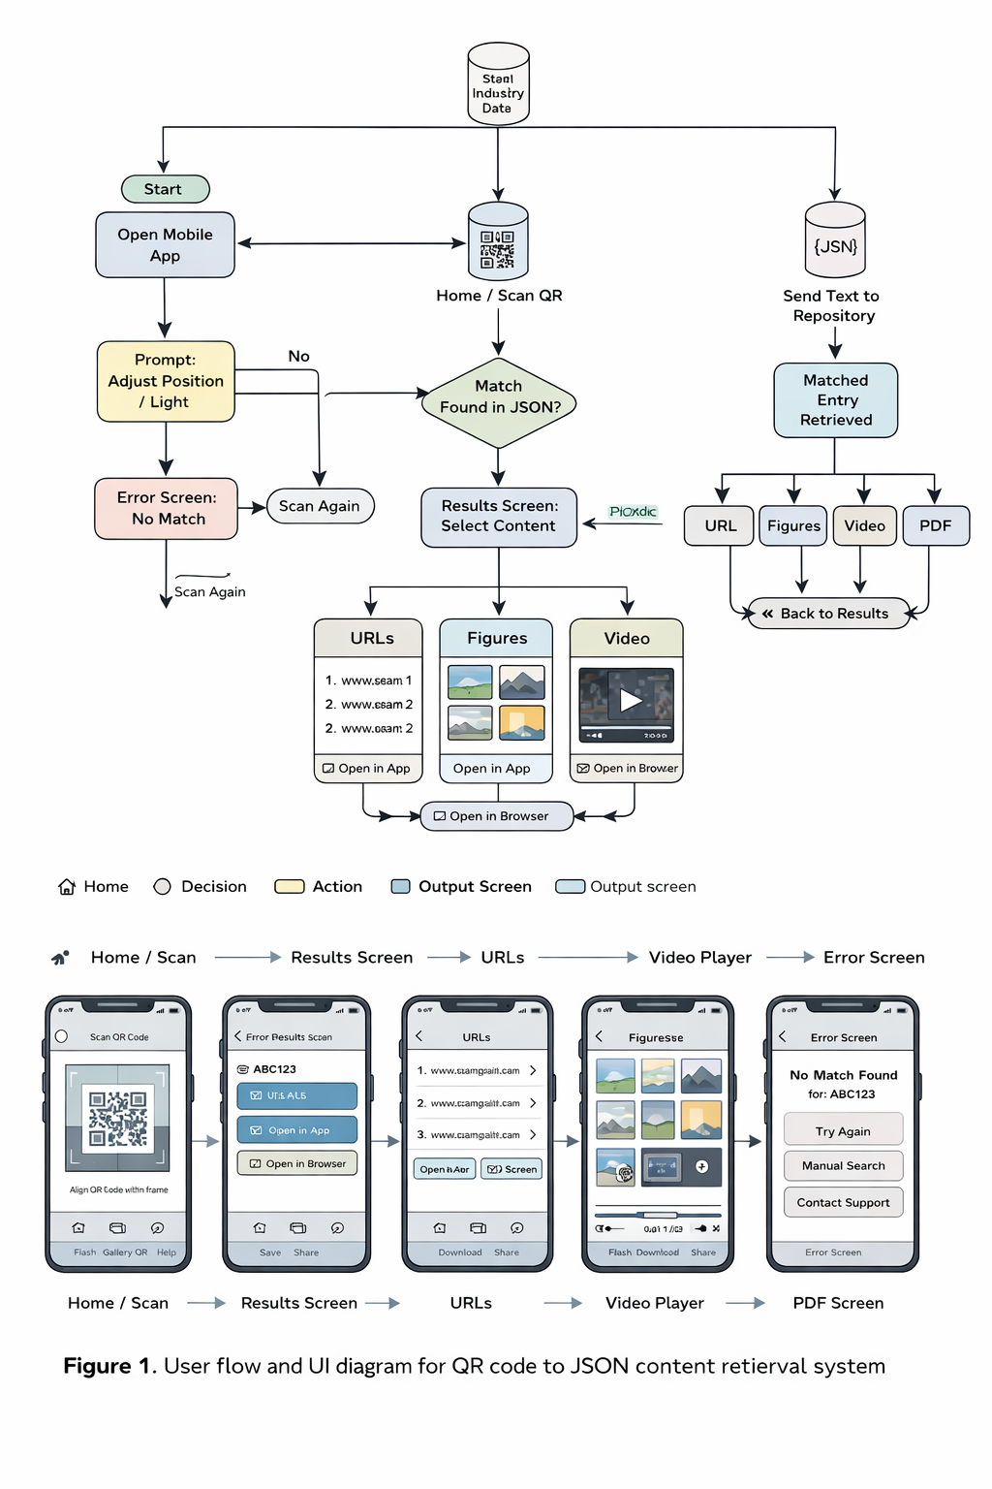

AUMOR
Start
{JSON}
Open Mobile App
QR
Code
Send Text to Repository
Select Option
Matched Entry Retrieved
Scan QR
Code
N
Match found in Json
Y
Result Screen: Select Content
Prod.url
Video
Data-sheet
Draw-ing
Vendor Contact
Open in Browser
Back to Results

Slide 3
AUMOR
Start
{JSON}
Open Mobile App
Send Text to Repository
Select Option
GPS Coordinate
Matched locations Retrieved
N
Match found in Json
Y
Matched Entry Retrieved
Select Location
Result Screen: Select Content
URL
Video
Document
Map
Booking
Open in Browser
Back to Results

Slide 4
Very unlikely
Unlikely
Neutral
Likely
Very likely
No answer

Slide 5
Situated Learning
Importance of context and social interactions in learning
Information Processing Theory
Acquisition, processing, and retention of information
AUMOR-AR
UX Design Principles
Simplicity, consistency, feedback, affordance
Spatial Cognition and Navigation
Perception and navigation of spatial environments

Slide 6
Project Planning
Prioritization
First Increment
Project Planning
Monitoring and Optimization
Continuous Integration & Development
Subsequent Increments
Development and Testing
Scaling and Expansion
Feedback Loop

Slide 7





Slide 8
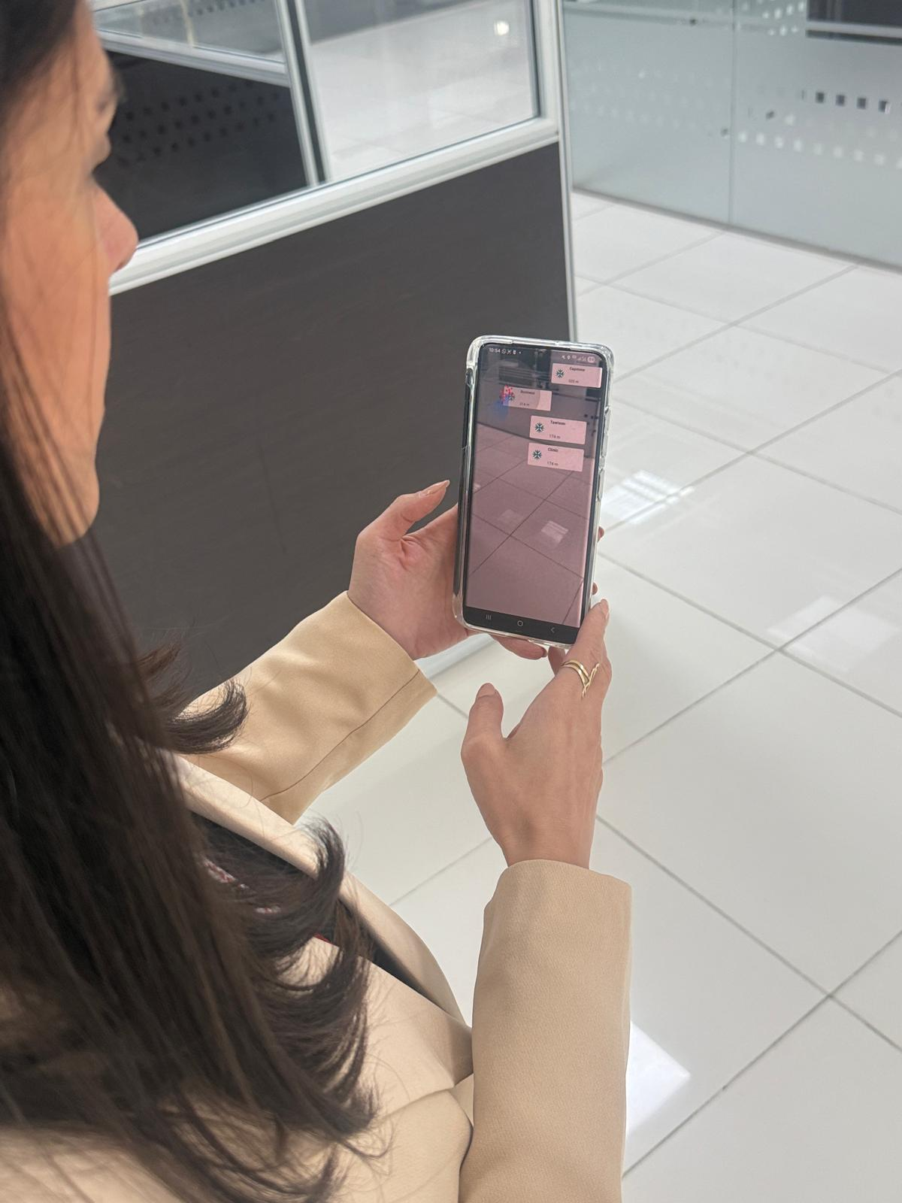
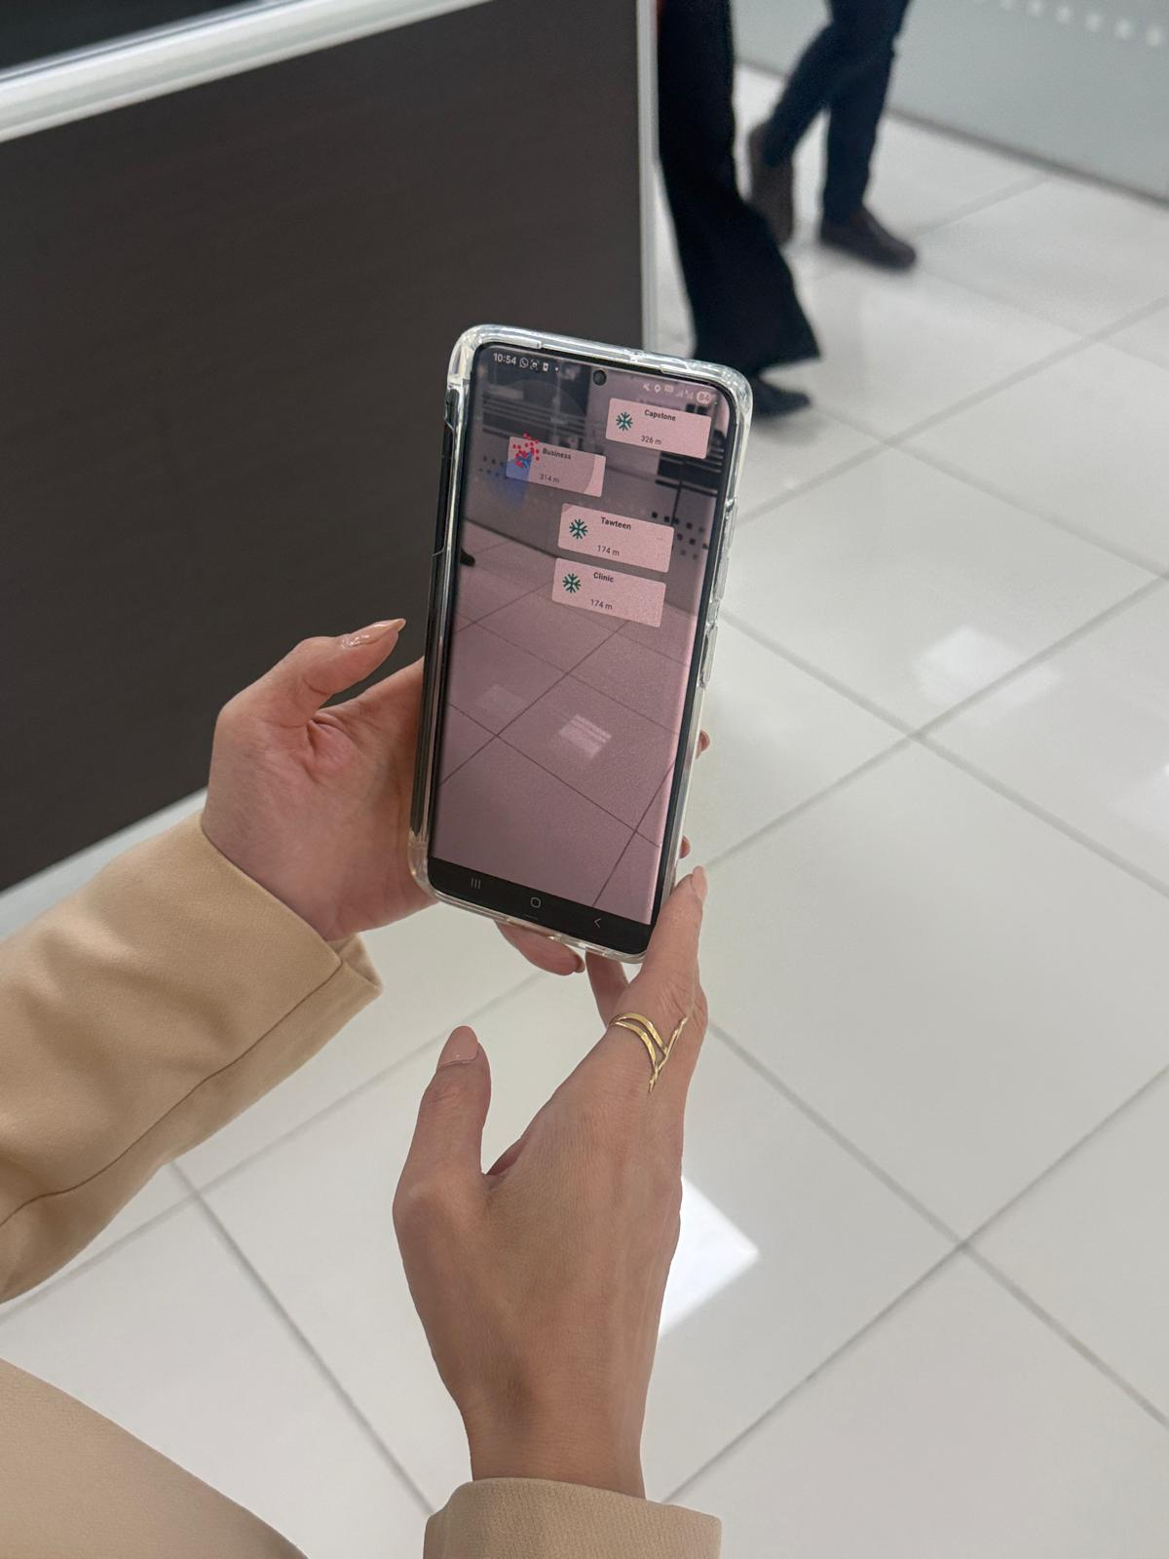
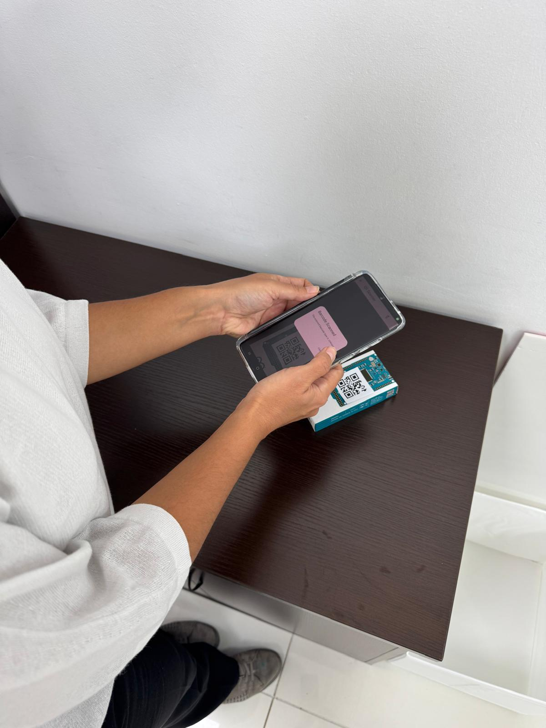
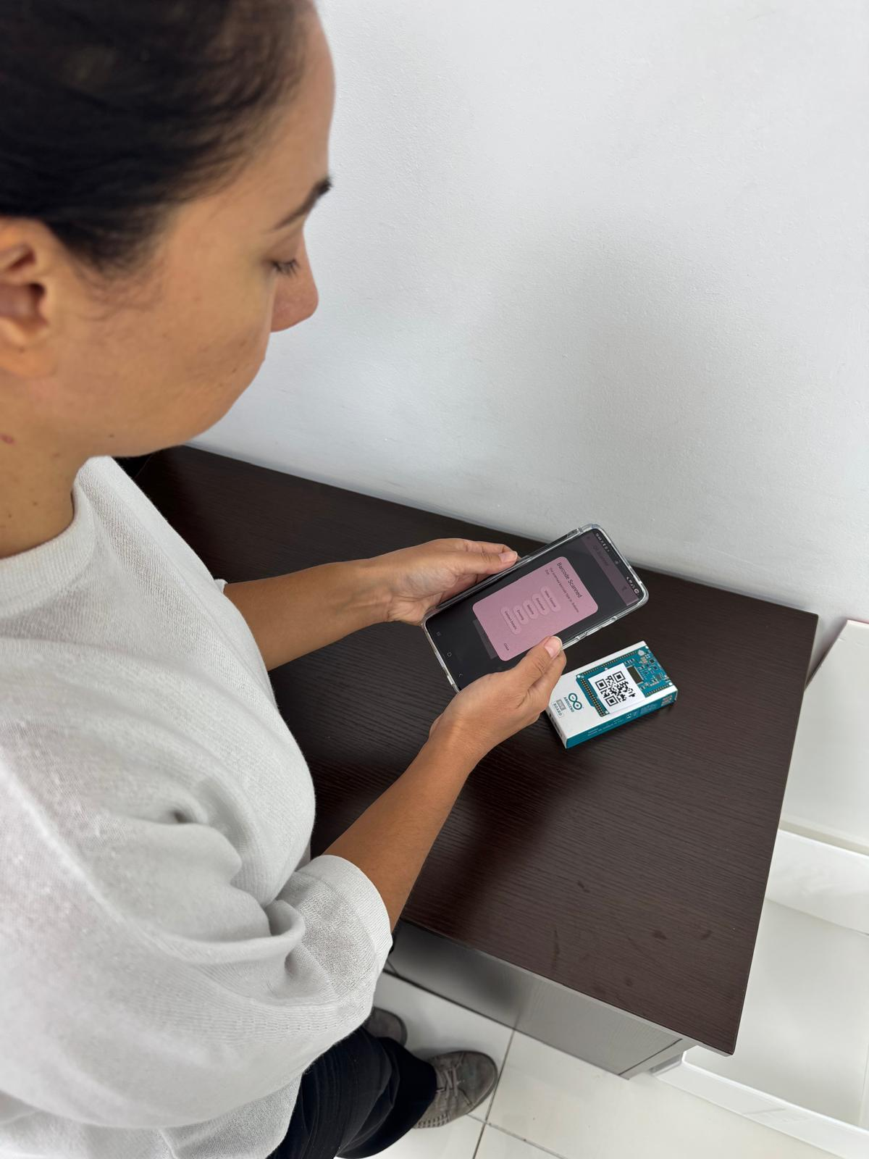
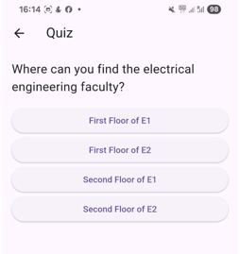
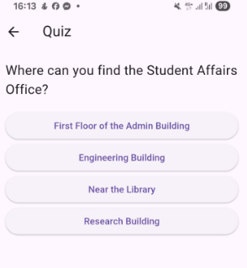
(a)
(b)
(c)
(d)
(e)
(f)

Slide 9
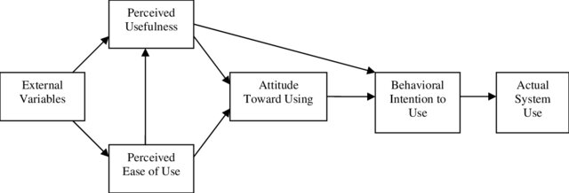
• H1: PEOU has a positive effect on PU.
• H2: PU has a positive effect on ATU.
• H3: PEOU has a positive effect on ATU.
• H4: ATU positively influences BIU.
• H5: PU positively influences BIU.
• H6: BIU positively AU.
Perceived Usefulness
H₂
H₅
External Variables
Attitude Toward Use
Behavioural Intention to Use
H₆
Actual System Use
H₄
H₁
Perceived Ease of Use
H₃

Slide 10
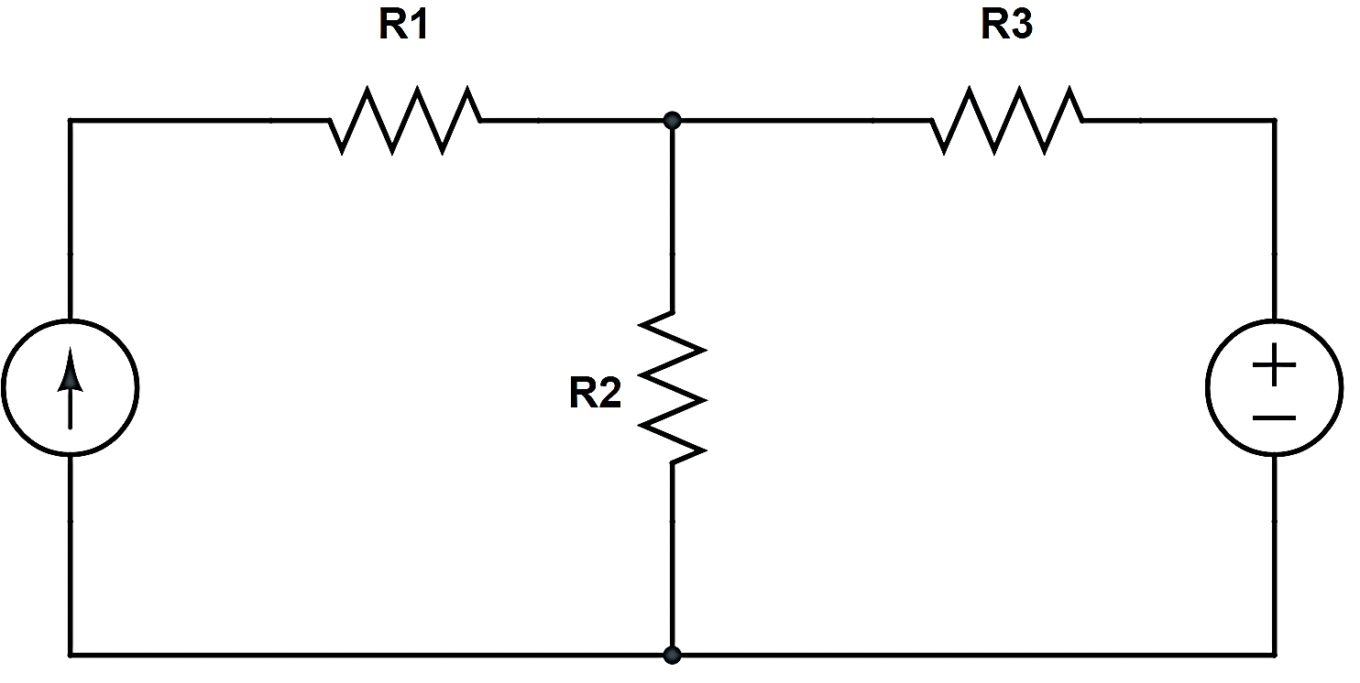
1

Slide 11
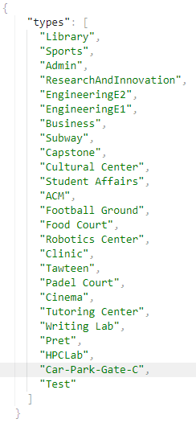
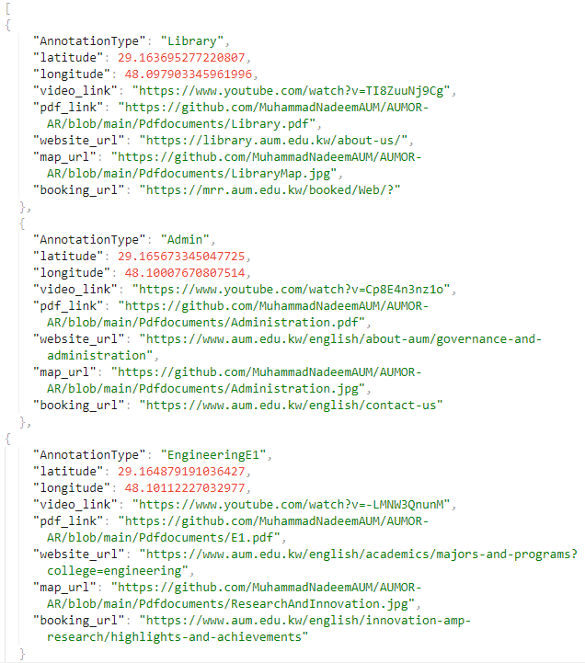
(a)
(b)

Slide 12
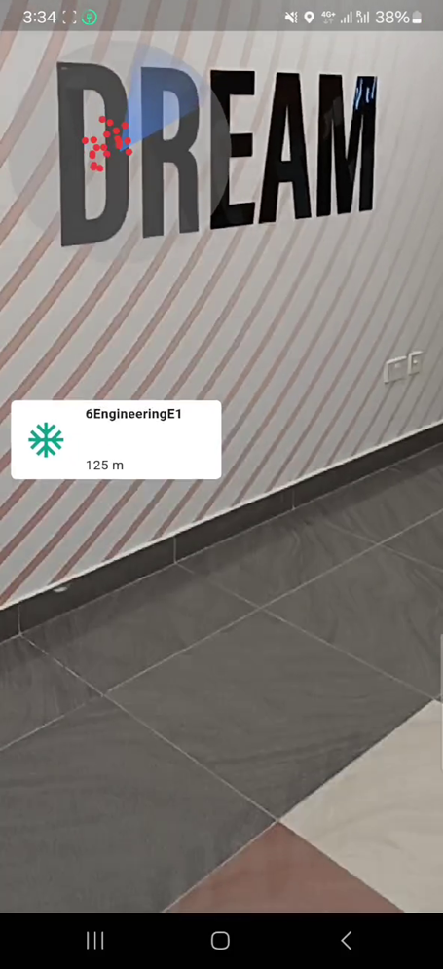
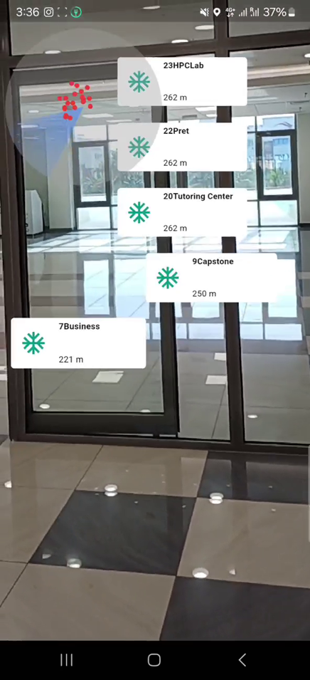
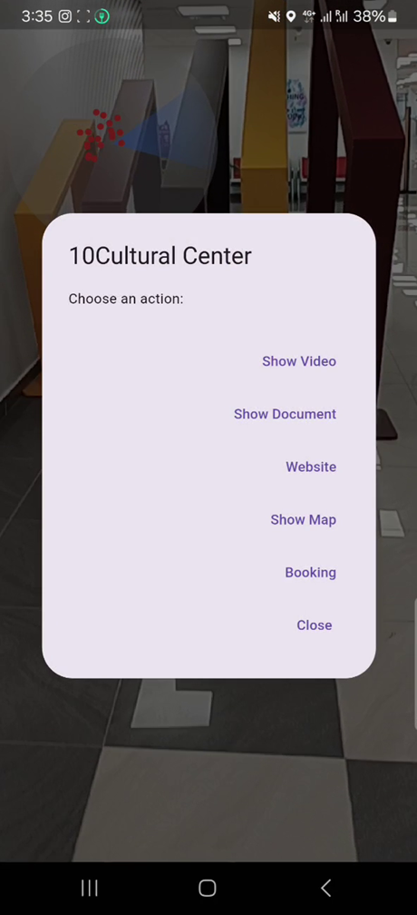
(a)
(b)
(c)

Slide 13
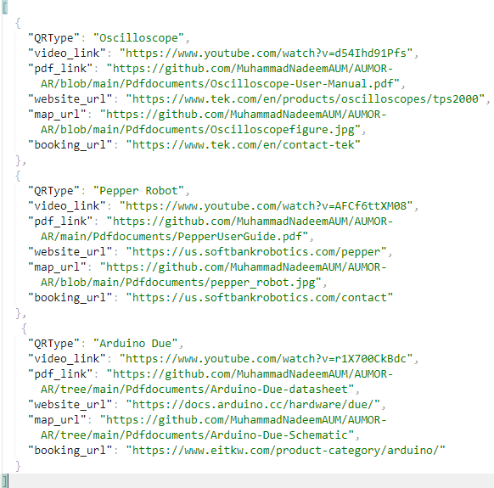
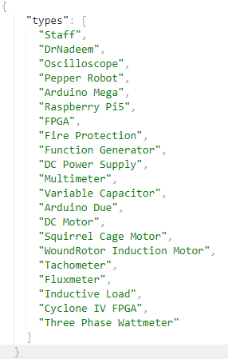
(a)
(b)

Slide 14



Slide 15
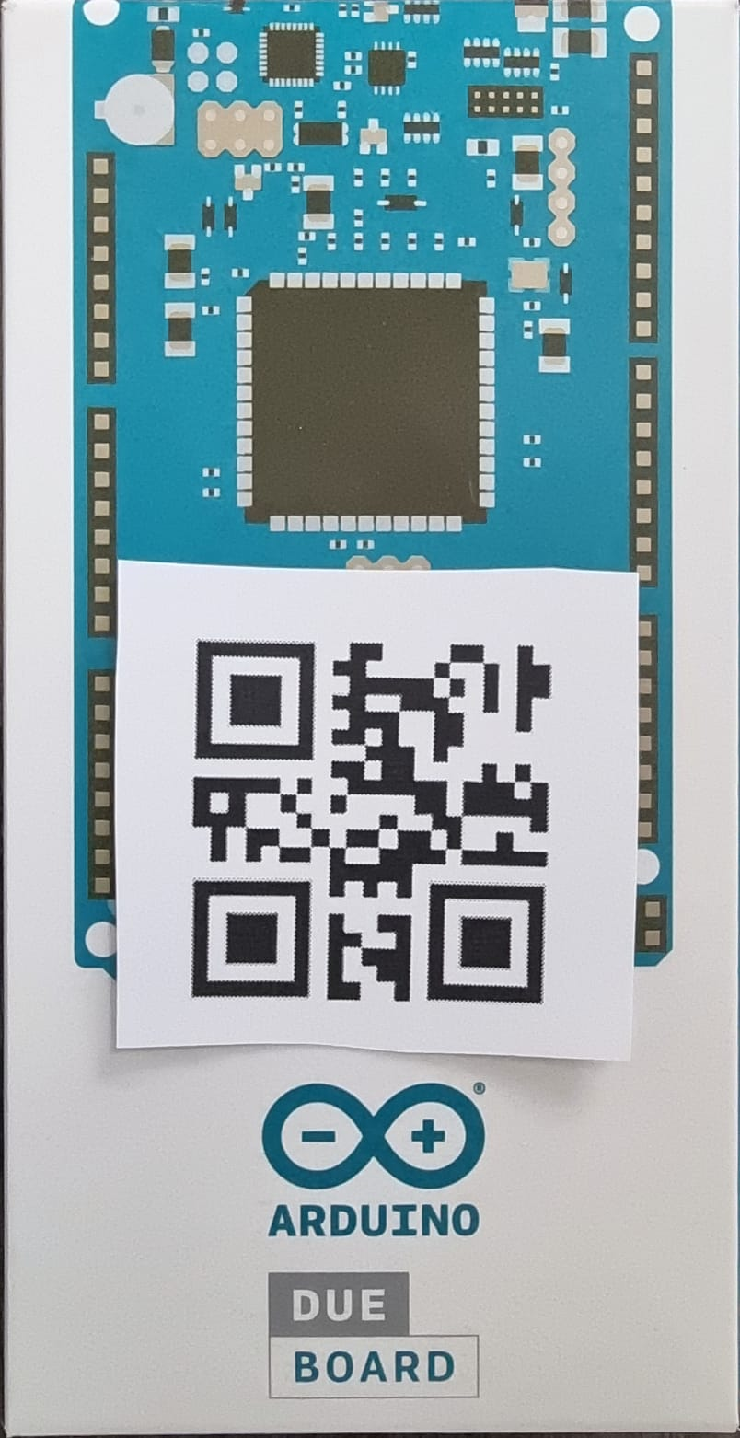
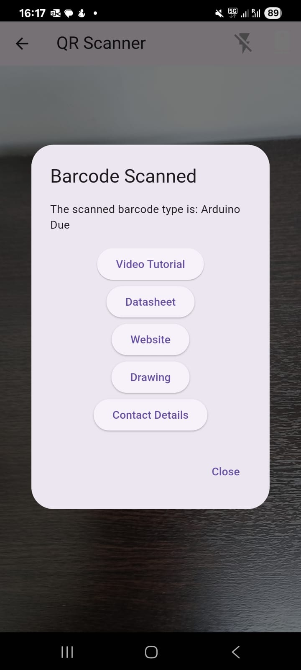
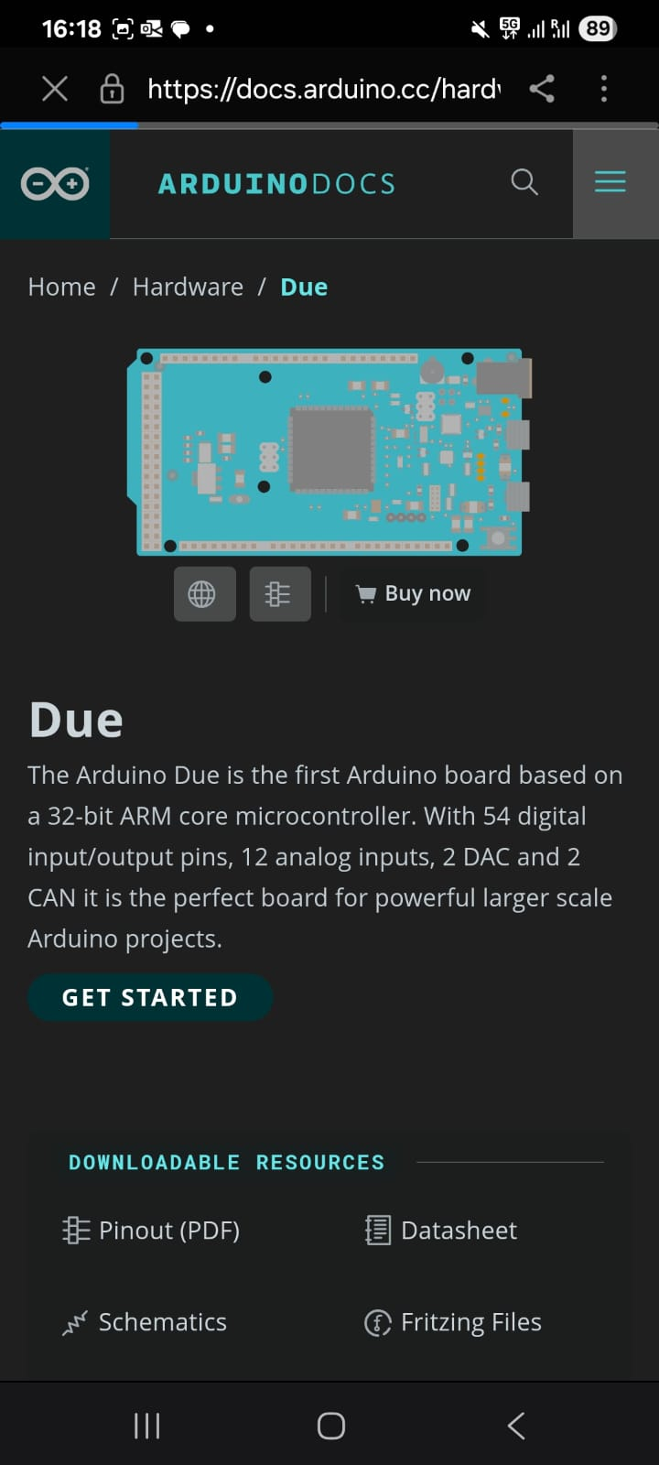
(a)
(b)
(c)

Slide 16
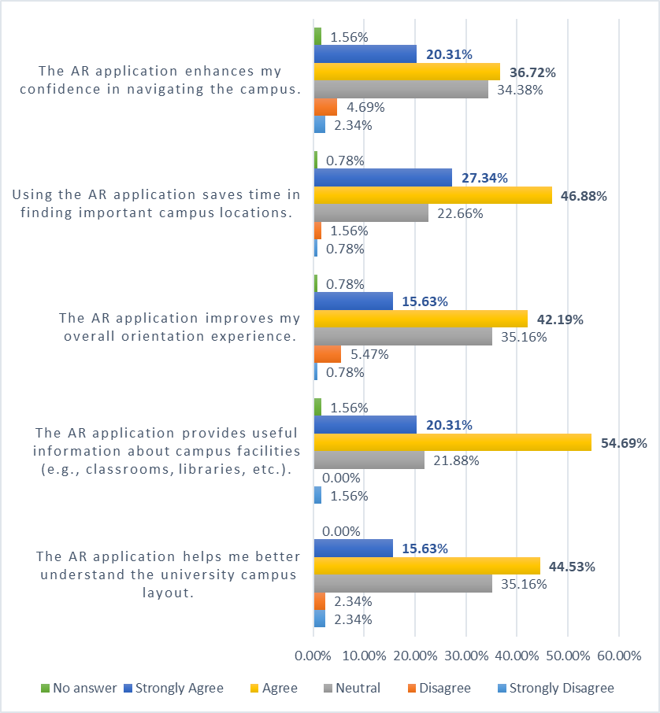
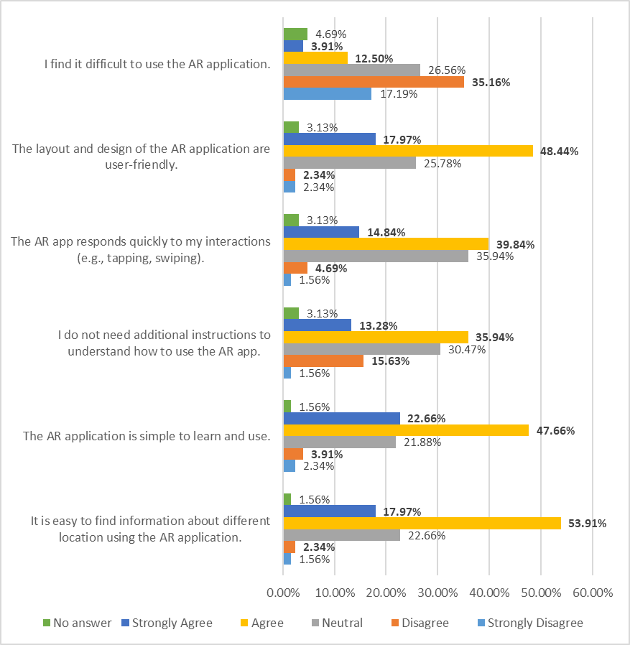
(a)
(b)

Slide 17
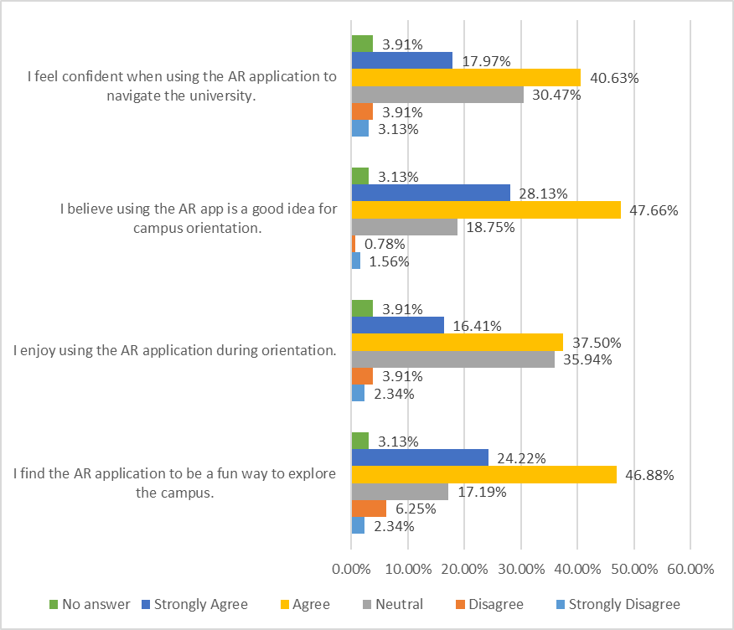
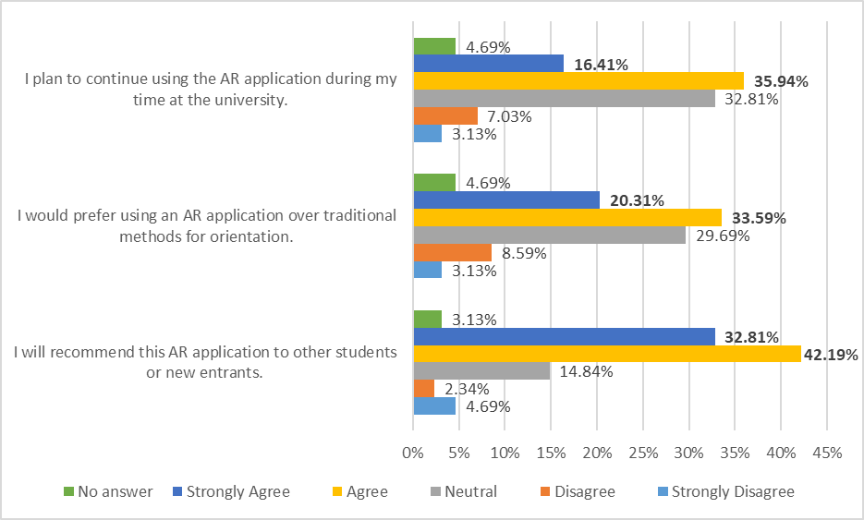
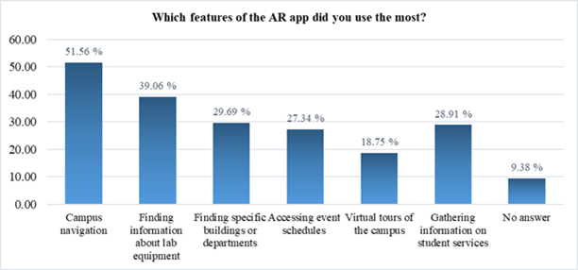
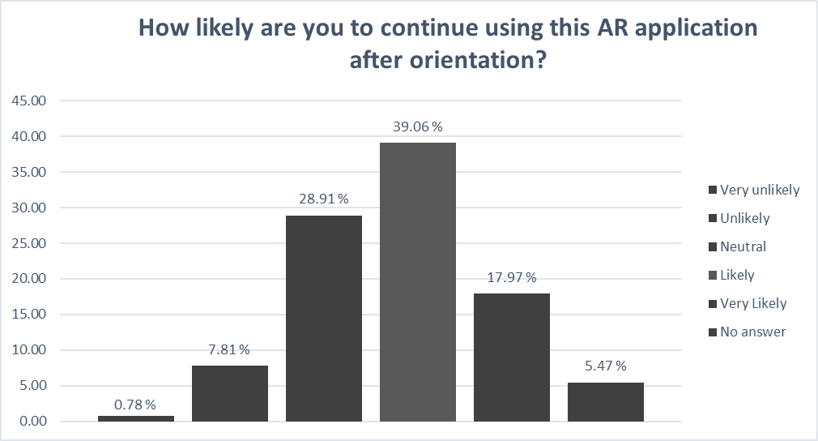
(c)
(d)
(e)
(f)

Slide 18
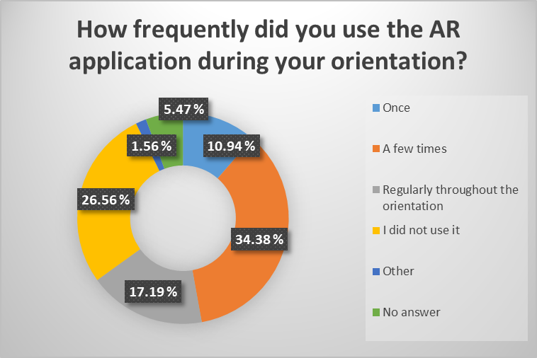
(g)

